Slide 1


Dhaka University of Engineering & Technology
FAKE NEWS DETECTION USING MACHINE LEARNING
Guided by
Presented by
Mr. Khawza Imran Masud
Mst. Sumaya Khatun
Abdul Owadud Raton (214033)
Md. Imon Hossain (214039)
Mesbaul Alam (214040)
Md. Al Fahad (214041)
Course Name: Information System Design and Information
Dept. of Computer Science and Engineering
20-07-25
1

Slide 2
CONTENTS
Abstract
Introduction
Objectives
Methodology
Tools And Technologies
Data Collection / Data Analysis
Machine Learning Models
Verification And Model Testing
User Interface
Conclusion
Questions And Discussion
Dept. of Computer Science and Engineering
20-07-25
2

Slide 3

ABSTRACT
Fake News has high potential to change opinions, facts and can be the most dangerous weapon in influencing society.
The proposed project uses a Machine Learning Model for detecting 'fake news', that is, misleading news stories that come from non-reputable sources.
The proposed project uses the datasets that are trained using the count vectorizer method for the detection of fake news and its accuracy will be tested using machine learning algorithms.
Dept. of Computer Science and Engineering
20-07-25
3

Slide 4

OBJECTIVES
The primary objective of the this project is to develop and implement a machine learning-based system capable of accurately identifying and classifying news articles as "fake" or "genuine.“
We will be working on different fake news data set in which we will apply different machine learning algorithms to train the data and test it to find which news is the real news or which one is the fake news.
Dept. of Computer Science and Engineering
20-07-25
5

Slide 5
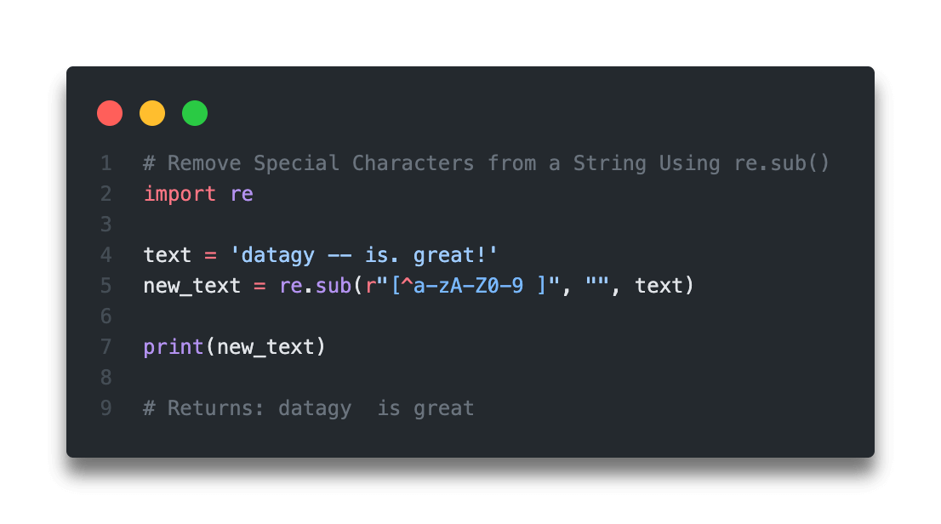
METHODOLOGY
1. Data Collection
Gather a labeled dataset of news articles (real or fake) from sources like Kaggle.
2. Data Preprocessing
Clean text data by removing HTML tags, special characters, and stop words.
Stop words such as "if," "the," "is," "a," and "an" should not be given much weight by a machine learning model because they are common English terms and do not contribute to the uniqueness or credibility of any narrative. Their presence in the dataset can affect the model's predictions due to their frequent usage.
Figure : Removal of Special Characters
Dept. of Computer Science and Engineering
20-07-25
6

Slide 6
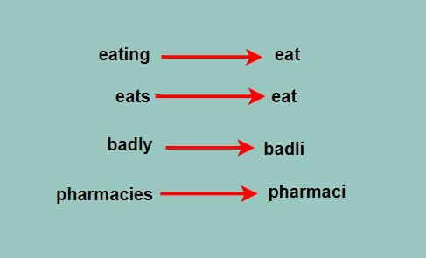
METHODOLOGY
Perform lemmatization and convert text to lowercase :
The word "play" acts as the base for other words like "playing" and "plays." Expanding the analysis of its frequency involves replacing the core word with its variations in different tenses and participles. Consequently, we substitute this word for any phrase derived from a single source word.
Figure : Transforming words to their base forms for more accurate text analysis.
Dept. of Computer Science and Engineering
20-07-25
7

Slide 7
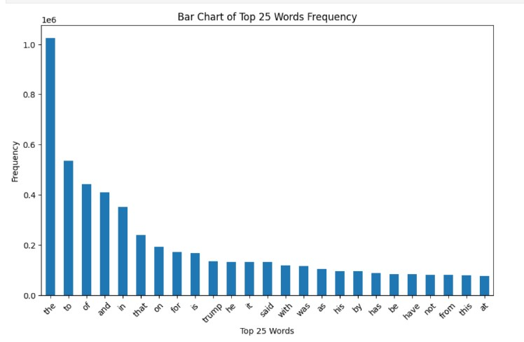
METHODOLOGY
3. Exploratory Data Analysis (EDA)
Analyze data distribution, word frequencies, and patterns in fake vs. real news.
Visualize data with plots and word clouds for insights.
Figure : Bar Graph of the Top 25 Most Frequent Words
Dept. of Computer Science and Engineering
20-07-25
8

Slide 8
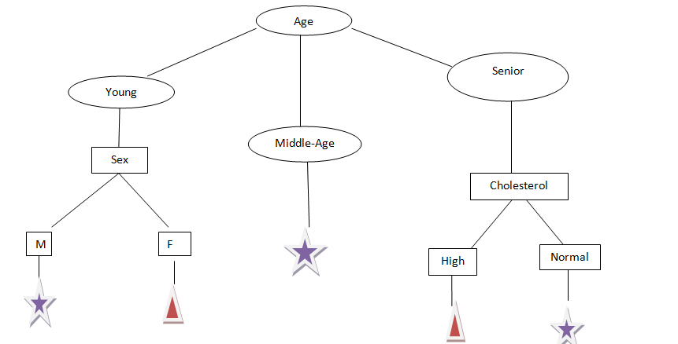
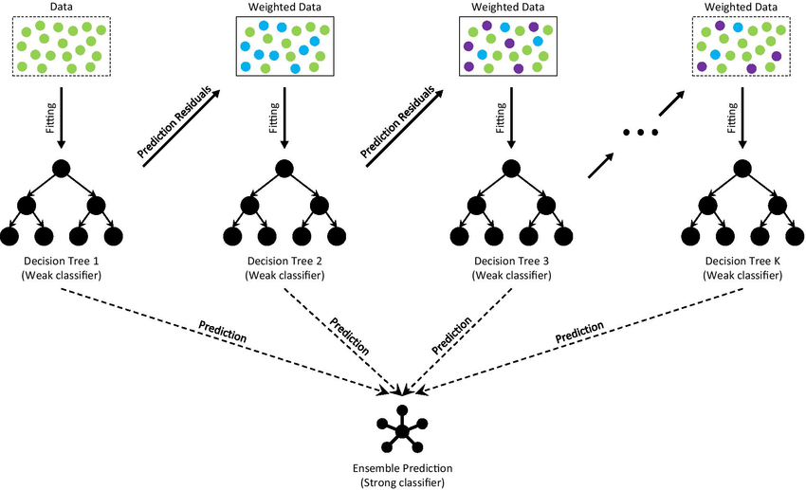
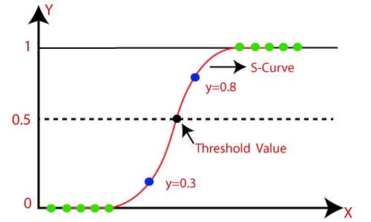
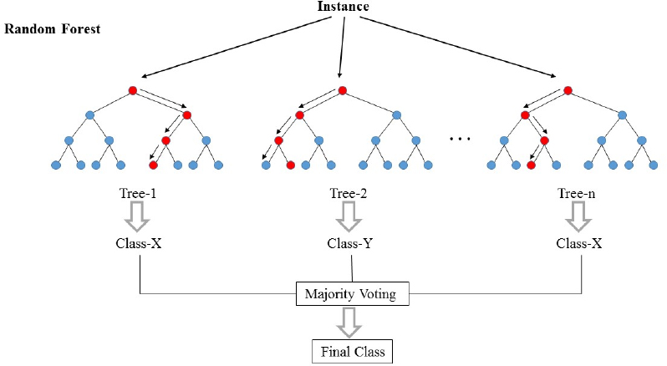
METHODOLOGY
4. Model Selection
Choose algorithms for classification:
Fig. (c) Decision Tree
Fig. (b) Gradient Boost
Fig. (a) Logistic Regression
Fig. (d)Random Forest
Dept. of Computer Science and Engineering
20-07-25
9

Slide 9





TOOLS AND TECHNOLOGIES
1. Programming Language :
Python , Java (For App Development)
Which Libraries we have used?
NumPy, Pandas, Matplotlib, Seaborn, Sklearn, and WordCloud
2. Data Collection :
Kaggle: For collecting news datasets.
3. Documentation and Reporting : Jupyter Notebooks
4. App Development: Android Studio
Dept. of Computer Science and Engineering
20-07-25
10

Slide 10
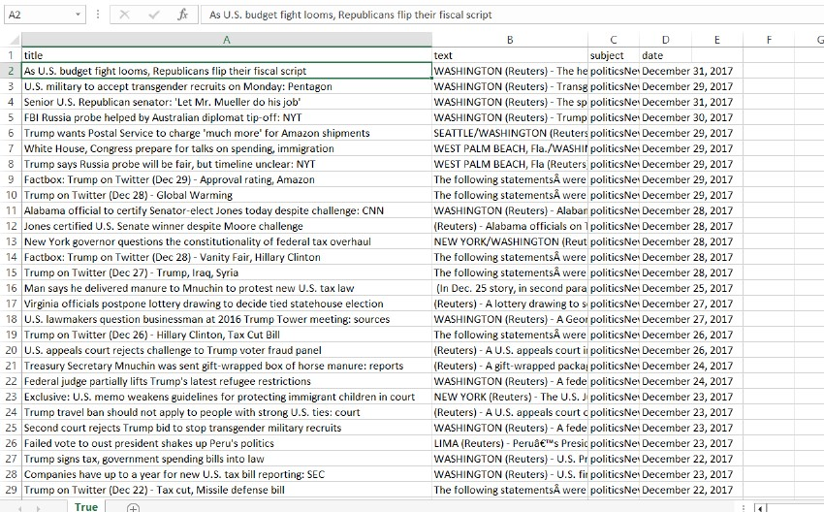
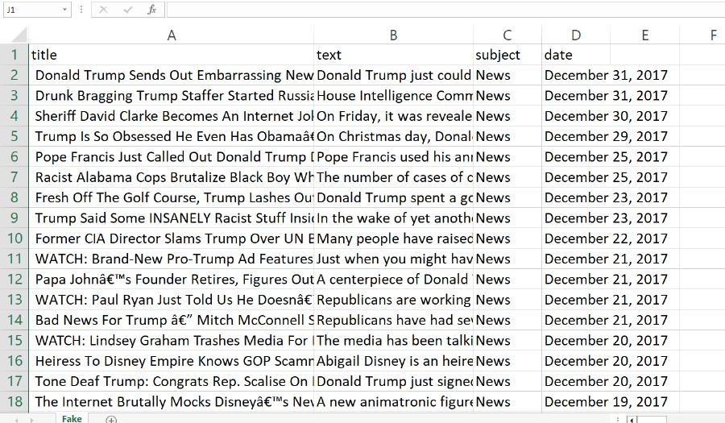
DATASETS
Fig.- True News Dataset
This dataset will contain articles that have been identified and labeled as true news.
Fig.- Fake News Dataset
This dataset will consist of articles that have been verified and labeled as fake news.
Dept. of Computer Science and Engineering
20-07-25
11

Slide 11
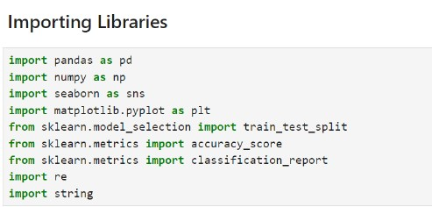
Importing Python Libraires
The next procedure to be followed is to launch jupyterlab using command prompt. The first step in jupyterlab is to import all the necessary libraries.
Figure : Importing Important Libraries
Dept. of Computer Science and Engineering
20-07-25
12

Slide 12
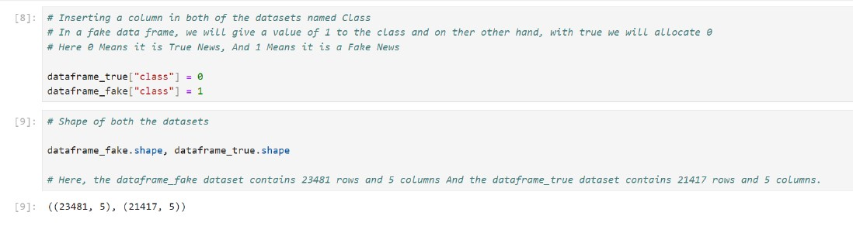
Shape of True And Fake News Datasets
Here, 0 Means it is True News, And 1 Means it is a Fake News.
Figure : Shape of both the Datasets
Dept. of Computer Science and Engineering
20-07-25
13

Slide 13
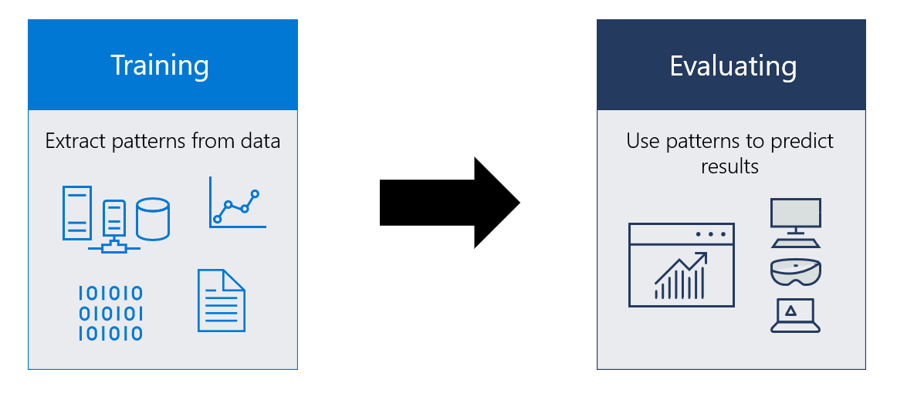
Machine Learning Models
Modeling involves creating a mathematical representation of a system or dataset by employing various techniques and algorithms. In this context, we'll utilize a range of machine learning algorithms to train them on the dataset, with the objective of predicting fake news.
Logistic Regression
Decision Tree
Gradient Boosting
Random Forest
Dept. of Computer Science and Engineering
20-07-25
14

Slide 14
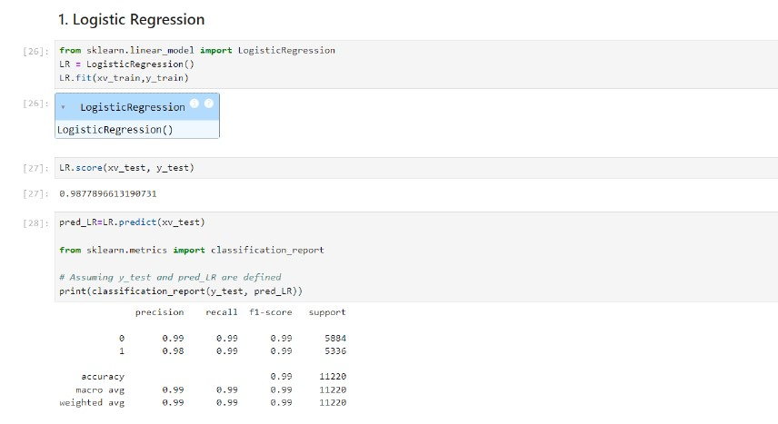
Logistic Regression
Logistic regression is a statistical method used in machine learning for binary classification tasks.
It models the probability that a given input belongs to a particular class.
Purpose:
To predict the probability of a binary outcome (e.g., yes/no, true/false, 0/1).
To classify data points into one of two categories.
Applications:
Spam detection (spam vs. not spam).
Medical diagnosis (disease vs. no disease).
Figure : Logistic Regression
Figure : Logistic Regression
Dept. of Computer Science and Engineering
20-07-25
15

Slide 15
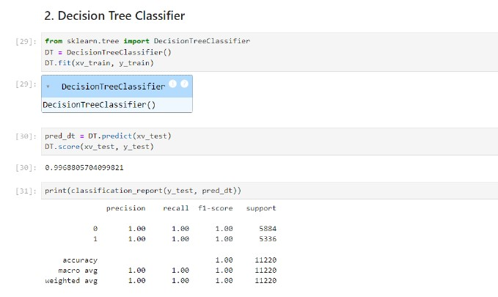
Decision Tree Classifier
A decision tree classifier is a supervised machine learning algorithm used for classification tasks. It recursively splits the dataset into subsets based on the values of input features, creating a tree-like structure of decision nodes.
Purpose:
To classify data points into multiple classes based on input features.
To represent a series of decisions as a tree structure.
Applications:
Credit risk assessment (approve vs. deny loan applications).
Customer segmentation (classify customers based on purchasing behavior).
Figure : Decision Tree Classifier
Dept. of Computer Science and Engineering
20-07-25
16

Slide 16
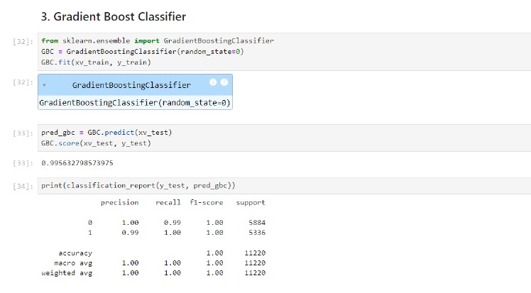
Gradient Boost Classifier
The Gradient Boost Classifier is a machine learning algorithm that builds a strong predictive model by combining multiple weak learners (typically decision trees) in a sequential manner.
Purpose:
To sequentially train a series of weak learners to correct the errors made by the preceding models.
To ensemble these weak learners into a strong predictive model.
Applications:
Predictive modeling in various domains, including finance, healthcare, and marketing.
Fraud detection.
Figure : Gradient Boost Classifier
Dept. of Computer Science and Engineering
20-07-25
17

Slide 17
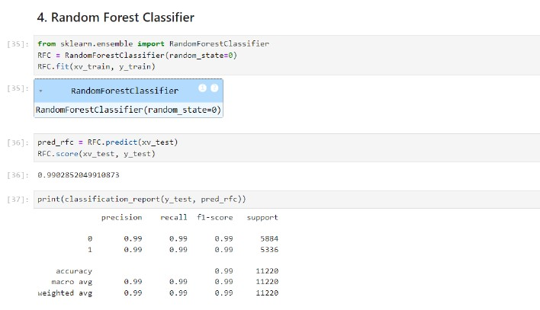
Random Forest Classifier
It can be used for both Classification and Regression problems in ML. It is based on the concept of ensemble learning, which is a process of combining multiple classifiers to solve a complex problem and to improve the performance of the model.
The greater number of trees in the forest leads to higher accuracy and prevents the problem of overfitting. It takes less training time as compared to other algorithms.
Applications:
Classification tasks where accurate predictions are required, such as in spam detection, image classification, and medical diagnosis.
Regression tasks where predicting continuous outcomes, such as in predicting house prices or stock prices.
Figure : Random Forest Classifier
Dept. of Computer Science and Engineering
20-07-25
18

Slide 18

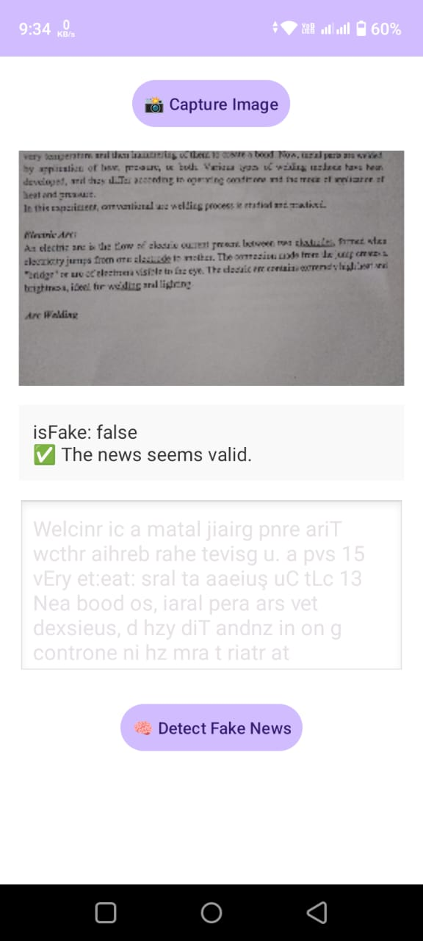
Model Testing For the Fake News
In the image provided, you can see the result based on the input I provided. The machine learning model thoroughly analyzed the data using various algorithms and confirmed that the news is fake.
Figure : Verification for the Fake News
Figure : Verification for the Fake News
Dept. of Computer Science and Engineering
20-07-25
19

Slide 19

Conclusions
Successful Detection: Our machine learning models demonstrated promising results in accurately distinguishing between real and fake news articles.
Model Performance: The program we picked did a really good job. It was right most of the time and could handle different kinds of news stories.
Impact : Detecting fake news helps people trust what they read and stops false information from spreading, which keeps us safer and more informed.
Future Directions: We can make our programs even better by using more data and trying out new ideas. We want to keep making progress and make sure our programs are fair and accurate.
Continuous Improvement: We should always keep learning and trying new things to make sure our work stays helpful and trustworthy in the long run.
Dept. of Computer Science and Engineering
20-07-25
20

Slide 20

Dept. of Computer Science and Engineering
20-07-25
21

Slide 21

Dept. of Computer Science and Engineering
20-07-25
21

